Slide 1
Data Mining - W8
Random Forests

Slide 2
Announcement
Mid-term Exam is in your Dropbox Folder
One week to work on it
6-hour maximum
Due April 06, 2020 at 5:35PM
Three parts
Multiple choice
Exploratory Data Analysis (EDA)
Build your own models (analysis)

Slide 3
Review of Decision Trees
Predict from a single regression tree: pass testing observations through the tree and use the mean of the training observations in the terminal node as the predictions

Slide 4
Classification Trees
Similar to regression trees, except that we use it to predict two classes rather than one continuous variable
We use confusion matrix, and accuracy to evaluate how the model performs on a test set or a holdout set

Slide 5
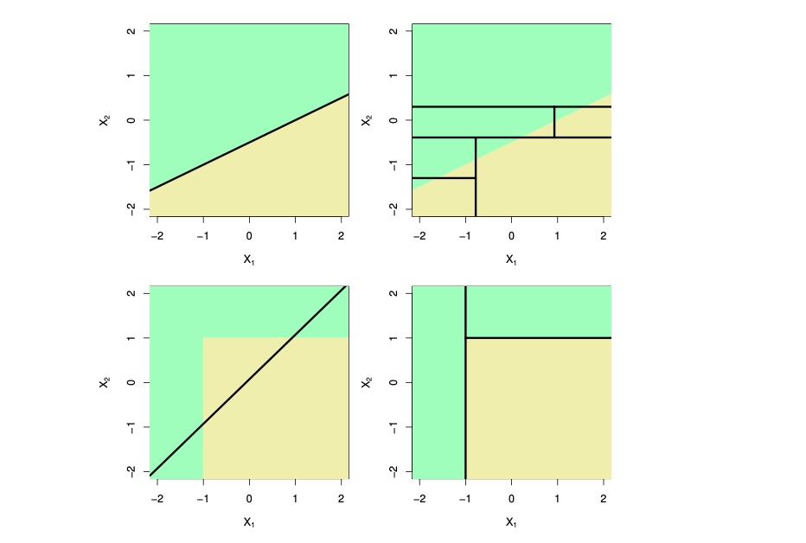
Linear (left) vs. Trees (right)

Slide 6
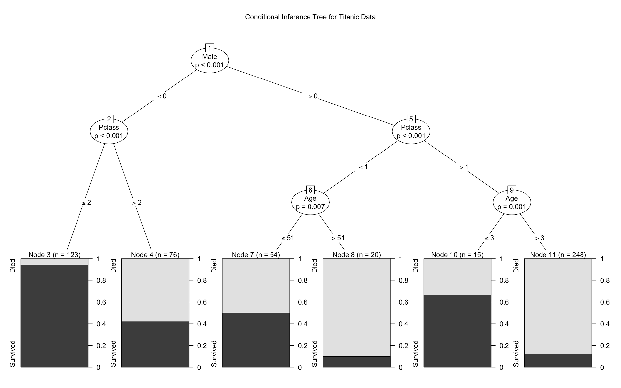

Slide 7
Interpretation
The Titanic Dataset:
Gender is the most important factor in determining whether one would survive or not.
Passenger class is the second most important variable in determining whether one would survive
Finally age is another contributing factor if passenger class is greater than 0

Slide 8
Summary of Single Decision Trees
Single Decision Trees are easy to interpret and explain
It’s a useful model of choice behavior, and can easily handle classification and regression problems
Have lower level predictive accuracy than other models (sometimes lower than logistic/OLS regression models)
But aggregated or ensemble decision trees have very high levels of predictive accuracy. They are among the best performing predictive methods!

Slide 9
Random Forests
Random forests are one ensemble approach that combine the insights of bootstrapping with the flexibility of decision trees
We will build a number of decision trees on bootstrapped training samples (called bagging)

Slide 10
Random Forests
Then we’ll decorrelate the trees with a minor adjustment: each time a split in a tree is considered, a random sample of m predictors is chosen as a split candidates from the full set of P predictors (often square root of P)
This reduces the variance when we average the trees

Slide 11
Boosting or Boosted Trees
Boosting aggregates the results of multiple decision trees, but does so through sequential process
Basic idea:
Fit a single decision tree to the entire data
Take the residuals from the result
Fit another tree to these residuals (or errors) from the result
Now fit another tree to these residuals
Repeat!

Slide 12
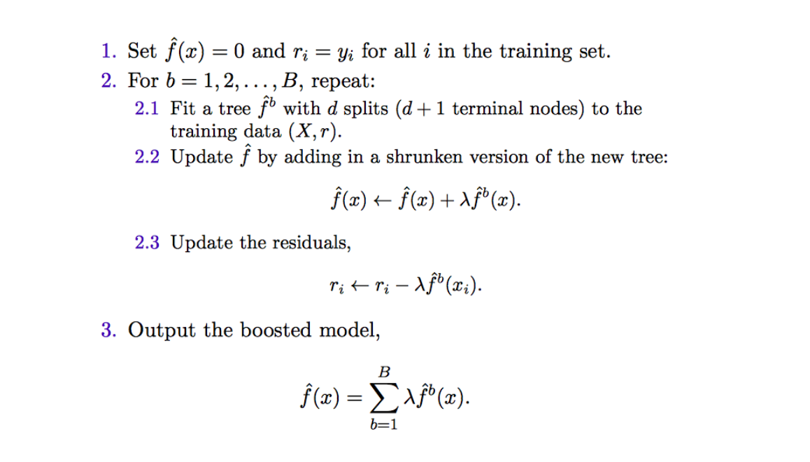
Boosting Algorithm

Slide 13
Intuition
When you fit a single decision tree to the data, you might overfit the data. With the boosting approach, you slowly fit the data, and reduce the error.
Each tree can be small, with only a few terminal nodes, determined by the parameter d (depth) in the algorithm
By fitting small trees to the residuals, we slowly improve f in areas where it does not perform well. The shrinkage parameters λ slows the process down even further, allowing more and different shaped trees to attack the residuals (reducing the errors)

Slide 14
Boosting or Boosted Trees
We need to tune the following parameters:
B - Number of trees
λ- the shrinkage parameter or learning rate
d - the number of splits or depth parameter
d is of special interest to use in social science
Gradient boosting generalizes the loss function with use of the gradient
Stochastic gradient boosting adds randomness by fitting trees to only some random subset of the data

Slide 15
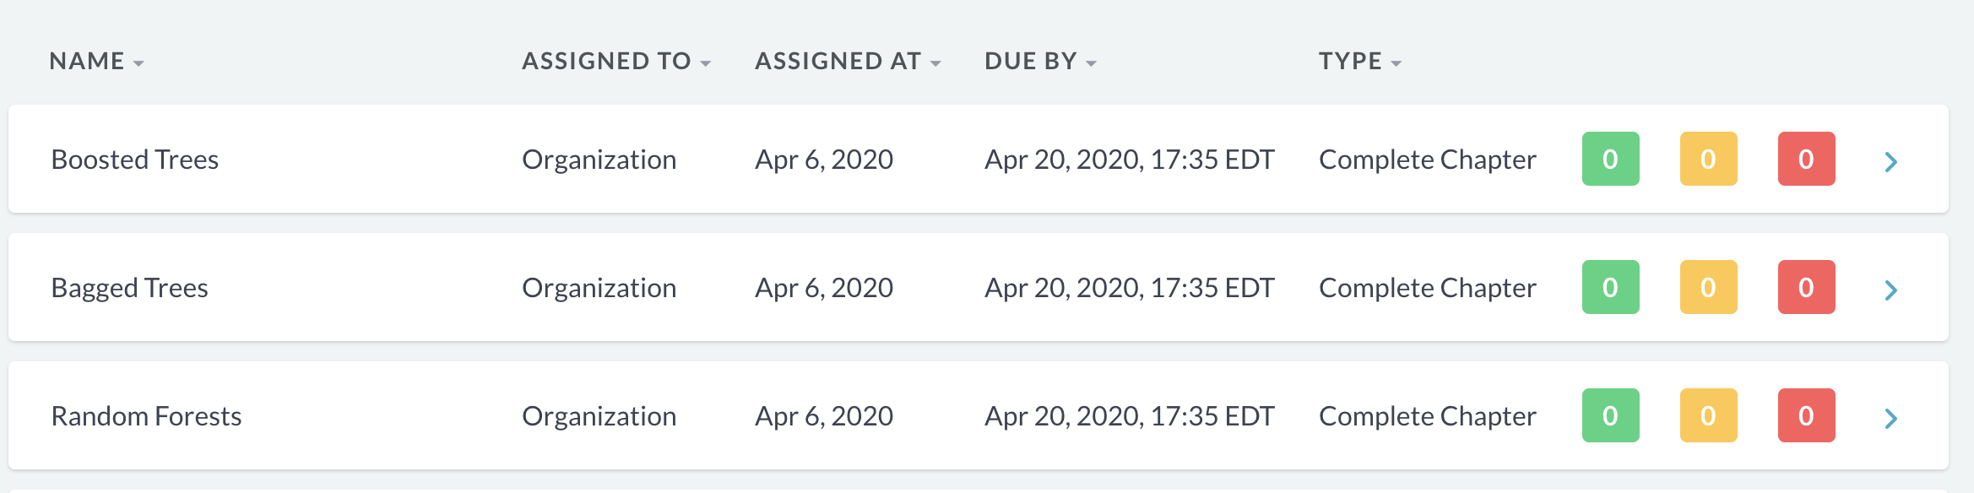
Homework
Random Forest on DataCamp

Slide 16
Lab
Data and R scripts are on Github, folder Week 8

